Slide 1
Special Disk Types
Mark L. McGinn
St. Ambrose University

Slide 2
Presentation Objectives
Virtual Disk Operations
Sparse
SSD Behaviors
Simple Flash
NAND based SSD drives

Slide 3
Hard Drive Format
Collection of sectors
512 or 4k per sector
Interleave pattern
Not physically contiguous
Accessed by CHS or LBA
No wear penalty for continuous reuse
Latency time penalty for seek
Optimized for access time

Slide 4
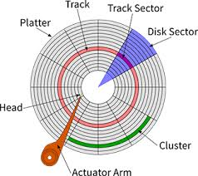
HD layout

Slide 5
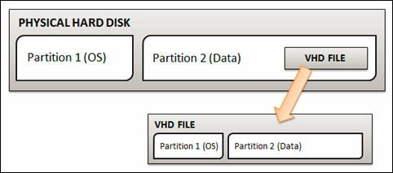
Virtual Machine HD
Two Options
Dedicate HD to VM
Drive format is the same as for real machine
Use a Dynamic drive structure
Host OS provides a file that the VM driver makes look like a physical HD

Slide 6
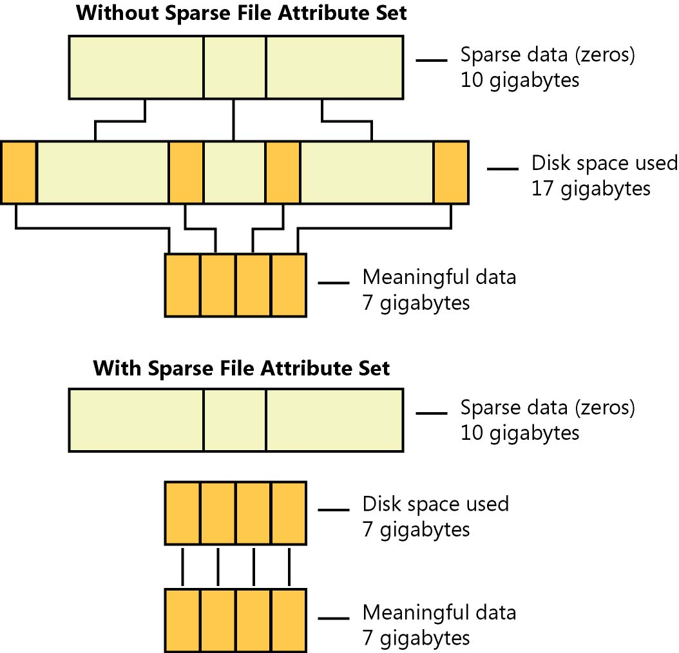
Sparse File Concept

Slide 7
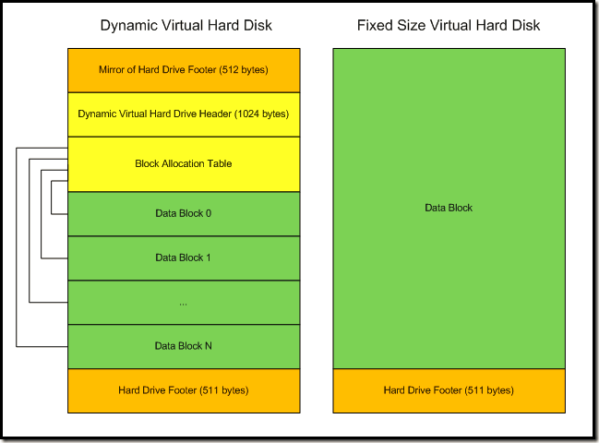
Internals of VDI

Slide 8
SSD Drives
Collection of NAND flash memory devices
Organized into blocks of pages
Pages can be written individually IF they are currently erased (all “1”s)
Blocks can only be erased as a single unit
Pages must be erased before writing
Location of logical blocks is not static
Mapped by SSD controller
May be erased only 100,000 or so times

Slide 9
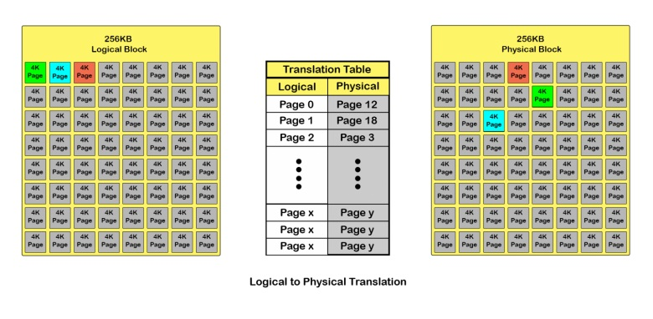
SSD Logical to Physical Mapping

Slide 10
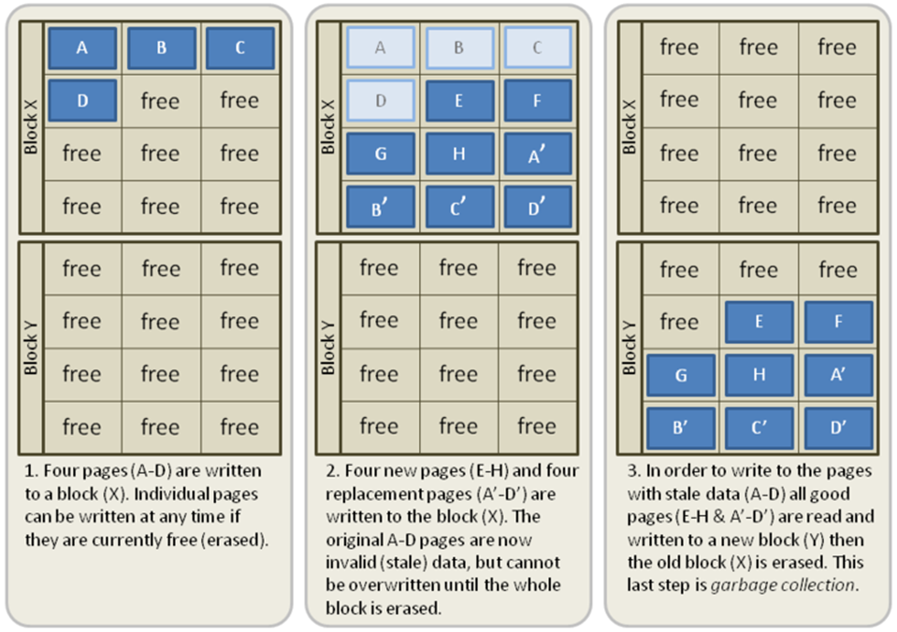
SSD writing and erasing process

Slide 11
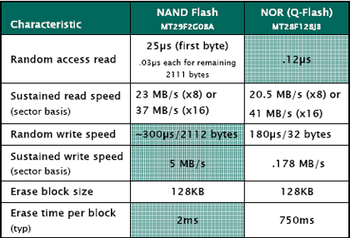
NAND Flash
NAND allows for fast page write and erase, smaller chip, much higher density
NOR allows random access and byte write

Slide 12
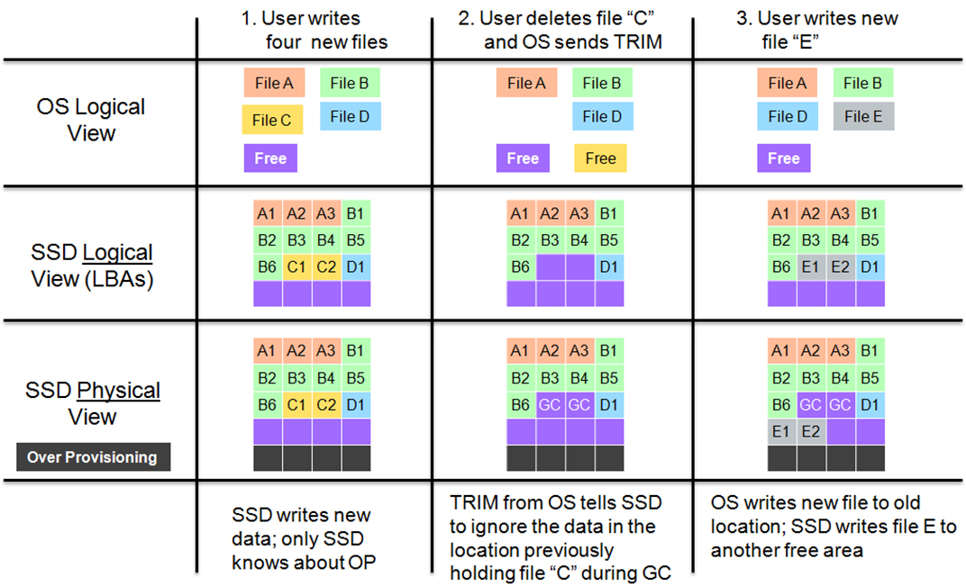
SSD Garbage collection

